Slide 1
Excercise 3 Increasing Well-Being with Data Analytics
Summer Term 2023
Notes:
Lassen Sie uns starten. Ich darf Sie recht herzlich begrüßen zur Veranstaltung IbG, eine Veranstaltung, die in den Themenbereich Entrepreneurship fällt.

Slide 2
Agenda
Data Analytics and Regression Analysis
Ordinary Least Squares (OLS)
Hypothesis Testing: The t-test
Notes:
Heute findet also der Kick-off zur Veranstaltung statt.
Ich werde Ihnen also einen Überblick über die Inhalte und Veranstaltungsteile geben.
Warum fokussieren wir gerade Internet-basierte Geschäftsmodelle?
Wie können Sie das, was Sie hier lernen, auch in der Praxis konkret anwenden?
Wie sieht die Struktur der Veranstaltung aus?
Welche Teilleistungen müssen Sie erbringen?

Slide 3
What is Data Analytics?
“a careful and complete analysis of data using a model, usually performed by a computer; information resulting from this analysis”.¹
Within data analytics (inferential), statistics are utilized to draw conclusions from a population sample in order to identify potential causal relationships between the independent and the dependent variables.²
Data Science and Data Analytics can be considered applied branches of statistics.³
1 Oxford Dictionary
Judd, Charles and, McCleland, Gary (1989). Data Analysis. Harcourt Brace Jovanovich. ISBN 0-15-516765-0.
Donoho, D. (2017). 50 years of data science. Journal of Computational and Graphical Statistics, 26(4), 745-766.

Slide 4
Regression Analysis
Comprehensive methodology to analyze quantitative data (usually including at least one numerical variable):
“set of statistical processes for estimating the relationships between a dependent variable and one or more independent variables.”
The most widely applied methodology to perform (inferential) statistical analyses
Typical data sources:
Survey, (Field) Experiment, Observational Data
Source: https://en.wikipedia.org/wiki/Regression_analysis

Slide 5
Agenda
Data Analytics and Regression Analysis
Ordinary Least Squares (OLS)
Hypothesis Testing: The t-test
Notes:
Heute findet also der Kick-off zur Veranstaltung statt.
Ich werde Ihnen also einen Überblick über die Inhalte und Veranstaltungsteile geben.
Warum fokussieren wir gerade Internet-basierte Geschäftsmodelle?
Wie können Sie das, was Sie hier lernen, auch in der Praxis konkret anwenden?
Wie sieht die Struktur der Veranstaltung aus?
Welche Teilleistungen müssen Sie erbringen?

Slide 6
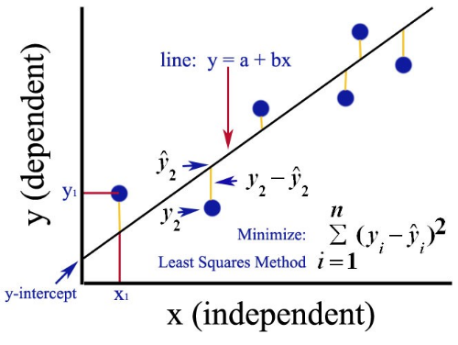
Fundamental Regression Model: ordinary least squares (OLS)
OLS: a method for estimating the unknown parameters in a linear regression model
line: ŷ = Xβ
Sources:
https://medium.com/analytics-vidhya/ordinary-least-square-ols-method-for-linear-regression-ef8ca10aadfc; https://en.wikipedia.org/wiki/Ordinary_least_squares

Slide 7
Fundamental Regression Model: ordinary least squares (OLS)
OLS: a method for estimating the unknown parameters in a linear regression model
line: ŷ = Xβ
Sources:
https://medium.com/analytics-vidhya/ordinary-least-square-ols-method-for-linear-regression-ef8ca10aadfc; https://en.wikipedia.org/wiki/Ordinary_least_squares

Slide 8
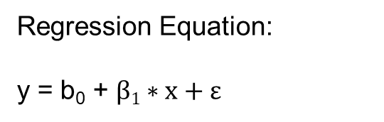
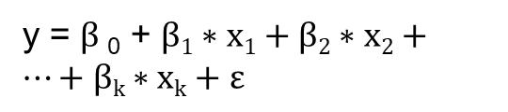
Fundamental Regression Model: ordinary least squares (OLS)
OLS: a method for estimating the unknown parameters in a linear regression model
Regression Equation:
y = b₀ + $β1∗x+ε$
line: ŷ = Xβ
y = $β$₀ + $β1∗x1+β2∗x2+…+βk∗xk+ε$
Sources:
https://medium.com/analytics-vidhya/ordinary-least-square-ols-method-for-linear-regression-ef8ca10aadfc; https://en.wikipedia.org/wiki/Ordinary_least_squares

Slide 9
Agenda
Data Analytics and Regression Analysis
Ordinary Least Squares (OLS)
Hypothesis Testing: The t-test
Notes:
Heute findet also der Kick-off zur Veranstaltung statt.
Ich werde Ihnen also einen Überblick über die Inhalte und Veranstaltungsteile geben.
Warum fokussieren wir gerade Internet-basierte Geschäftsmodelle?
Wie können Sie das, was Sie hier lernen, auch in der Praxis konkret anwenden?
Wie sieht die Struktur der Veranstaltung aus?
Welche Teilleistungen müssen Sie erbringen?

Slide 10
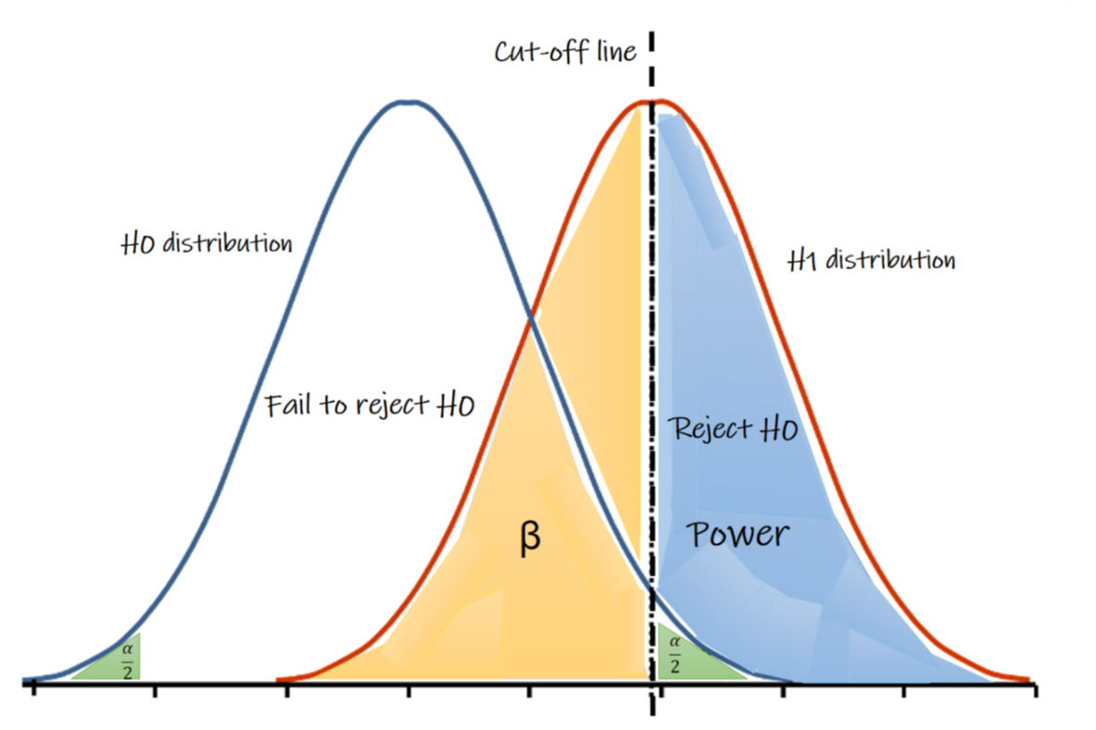
Hypothesis Testing: The t-test
To test if we have a significant independent variable, we can use hypothesis testing, such as a t-test.
To understand hypothesis testing, we have to think of two variables:
H0: Null hypothesis — the default no-difference hypothesis we are trying to reject.
H1: Alternative hypothesis — the difference hypothesis.
α (type 1 error)
Source: https://medium.com/evidentebm/the-value-of-the-p-value-9460797a92d6

Slide 11
Hypothesis Testing: The t-test
The β estimators are derived from randomly distributed data; therefore, parameter values of OLS regressions can be tested.
To test if an independent variable of regression has a significant relationship with our dependent variable, we set our hypothesis as follows:
H0: Null hypothesis β = 0 | H1: Alternative hypothesis β ≠ 0
α (type 1 error)
Source: https://medium.com/evidentebm/the-value-of-the-p-value-9460797a92d6

Slide 12
Regression: P-Value
As a result of the t-test, we receive a p-value.
The p-value and a self-defined cut-off of α (usually 0.05) indicate if the value of β is statistically significant.
If p-value<α (e.g., p-value=0.02), we reject the null hypothesis and say there is a statistically relevant difference, but if p-value≥α (e.g., p-value=0.50), we cannot reject the null hypothesis and there is no statistically relevant difference.
The p-value indicates the probability of the result occurring by chance.
Source: https://medium.com/evidentebm/the-value-of-the-p-value-9460797a92d6

Slide 13
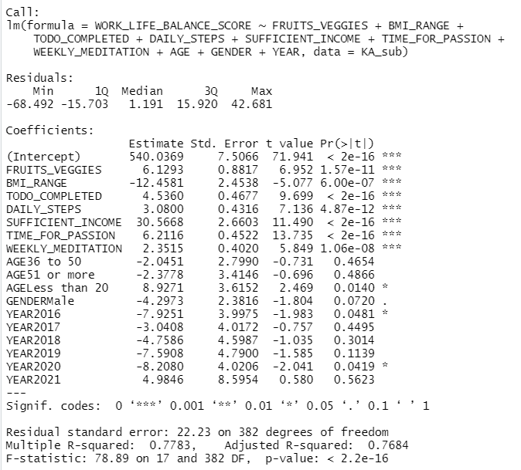
OLS-Regression output in R
regression model
parameter estimates
p-values

Slide 14

Thank You!

